Slide 1

Sauce & Spoon
Tablet Rollout
Impact Report

Slide 2
Executive Summary
In order to reach annual growth and expansion goals, Sauce & Spoon installed tabletop tablet menus at the Downtown and North locations, with the tablets going live to guests on October 15. After sourcing and installing the tablets, training the staff, and a successful test run, we launched a pilot of the tablets, and gathered customer feedback through a survey that appeared on their devices at the end of their meal. Using that information, we implemented improvements to the operations, including continued waitstaff training, tablet audits to surface faulty devices, investigating instances of food waste, and more.
Now that we’ve officially launched the tablets, we’ve increased the average daily guest count by 10%, decreased wait time by 30 minutes, cut checkout time down to one minute, and decreased food waste by 50%. Sales have gone up upwards of 20% since the rollout. Customer satisfaction has also increased from 72% after the initial pilot to 86% today. This, of course, shows us that there’s still room for improvement, which we will continue to make as we explore rolling out tablets to other Sauce & Spoon locations in the near future.

Slide 3
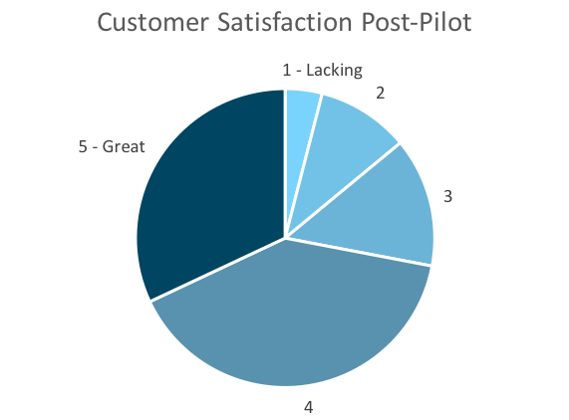
Customer Satisfaction: Pilot
Q. On a scale of 1-5, please rate your experience with the tablet overall.
This pie chart illustrates the results from the post-pilot survey.
72% of respondents indicated a customer satisfaction score of 4 or 5.
Notes:
First pie chart: Results from the post-pilot survey
Second pie chart: Results from the post-launch survey, after making changes
Satisfaction has gone up from 72% (4 and 5 rating) to 86% (4 and 5 rating)
Post-pilot data:
1 - Lacking 2 4%
2 5 10%
3 7 14%
4 20 40%
5 - Great 16 32%
Post-launch data:
1 - Lacking 1 2%
2 2 4%
3 4 8%
4 22 44%
5 - Great 21 42%

Slide 4
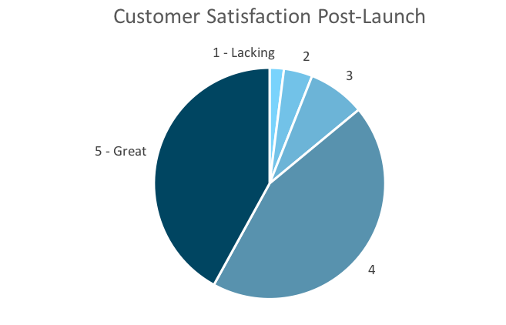
Customer Satisfaction: Launch
Q. On a scale of 1-5, please rate your experience with the tablet overall.
This pie chart illustrates the results from the post-launch survey.
86% of respondents indicated a customer satisfaction score of 4 or 5. This is a 14% increase.
Notes:
First pie chart: Results from the post-pilot survey
Second pie chart: Results from the post-launch survey, after making changes
Satisfaction has gone up from 72% (4 and 5 rating) to 86% (4 and 5 rating)
Post-pilot data:
1 - Lacking 2 4%
2 5 10%
3 7 14%
4 20 40%
5 - Great 16 32%
Post-launch data:
1 - Lacking 1 2%
2 2 4%
3 4 8%
4 22 44%
5 - Great 21 42%

Slide 5
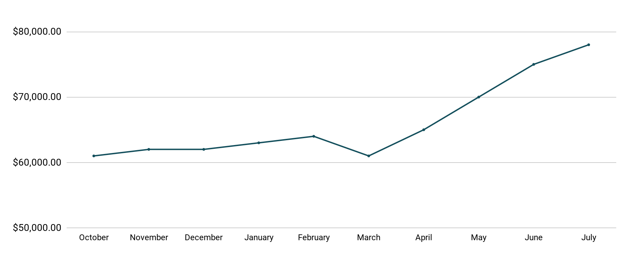
Revenue
Tablet Launch April 23
This is a chart of Sauce & Spoon revenue, showing that after tablet implementation, revenue increased.
July revenue was up to 20% over April’s monthly revenue.
Notes:
This is a chart of Sauce & Spoon revenue, showing that after tablet implementation, revenue increased. December revenue was up to 20% over September’s monthly revenue.
Sales data:
October
$61,000.00
November
$62,000.00
December
$62,000.00
January
$63,000.00
February
$64,000.00
March
$61,000.00
April
$65,000.00
May
$70,000.00
June
$75,000.00
July
$78,000.00

Slide 6
What Worked: Key Accomplishments
Decreased table turn time
Implementation of the tablets increased the average daily guest count by 10%.
Tablets also decreased wait time by 30 minutes.
Decreased food waste
Tablets identified who was receiving an incorrect order.
Kitchen staff has taken the initiative to correct orders and decrease food waste by 50%.
Increased customer satisfaction
After the pilot, customer satisfaction was at 72%.
Once we implemented improvements based on feedback, customer satisfaction increased to 86%.
Increased sales
Our monthly revenue has increased steadily since the tablet rollout, upwards of 20% since September/pre-rollout.
Tablets also helped boost revenue during the holiday season.

Slide 7
Next Steps: Looking Forward
Initiative | Action | Date
Implement tablets in more locations | Create new project plan for new location installation | Q2
Continue to track customer experience and satisfaction | Continue surveying/ gathering data through various means | Ongoing
Expand tablet features | Investigate new features like social media integration, reservations, videos, etc. | Q4

Slide 8
Appendix
Access all resources here.
Notes:
Insert link to your shared drive or a shared folder with all of the relevant project artifacts

